Slide 1
UPPER SIXTH ARTS
GEOGRAPHY
Quantitative Techniques 2
Data Collection: Sources and Techniques
Notes:
Good morning, class, and welcome to our geography lesson. I am your geography teacher, Mr Kamdem. Today we are starting Quantitative Techniques 2: Data Collection: Sources and Techniques.

Slide 2
CLASS INFO
Class, Chapter and Duration
Class | Upper Sixth Arts
Chapter | Module 8: Understanding and carrying out statistical techniques, topographic map analysis, fieldwork and project based learning
Duration | 2 periods (2 × 50 minutes)
Notes:
This lesson is for Upper Sixth Arts. It belongs to Module 8: Understanding and carrying out statistical techniques, topographic map analysis, fieldwork and project based learning. We shall need 2 periods to cover it.

Slide 3
IDENTIFICATION
Lesson Identification
Topic | Quantitative Techniques in Geography
Sub-topic | Statistical Techniques
Lesson | Quantitative Techniques 2: Data Collection: Sources and Techniques
Notions / Concepts | Geographical data, primary data, secondary data, population, sample, random, systematic and stratified sampling, observation, measurement, questionnaire, interview, focus group.
Syllabus focus | Sources of geographical data (primary and secondary); basic sampling procedures (random, systematic, stratified); primary data collection techniques.
Competence | Learners are able to choose sources, sampling methods and techniques to collect data for a geographical investigation in Garoua.
Notes:
Our topic is Quantitative Techniques in Geography, and the sub-topic is Statistical Techniques. The key notions we shall use today are: geographical data, primary data, secondary data, population, sample, random, systematic and stratified sampling, observation, measurement, questionnaire, interview, focus group. At the end, you should be able to do this: learners are able to choose sources, sampling methods and techniques to collect data for a geographical investigation in Garoua.

Slide 4

HOMEWORK CORRECTION
Correction of the Homework
Question (Quantitative Techniques 1: Analysis of Cartographic Tools):
Name two sources of secondary data.
Notes:
Before we start the new lesson, let us correct the homework I gave you at the end of Quantitative Techniques 1: Analysis of Cartographic Tools. The question was: Name two sources of secondary data. Take out your exercise books.

Slide 5
HOMEWORK CORRECTION
Correction: Possible Answer
Census reports (BUCREP), statistical yearbooks (INS), books, maps, newspapers or websites (any two).
Notes:
Here is a good answer. Census reports (BUCREP), statistical yearbooks (INS), books, maps, newspapers or websites (any two). Compare it with your own answer and correct your work in red.

Slide 6
LESSON PLAN
Lesson Plan
Correction of the homework
Objectives and recall
Real-life situation and action to take
Learning activities
Board summary
Evaluation, remediation and homework
Notes:
Here is the plan of our lesson today. First, we shall correct the homework. Then we shall look at the objectives and recall what you already know. After that, we shall study a situation from real life and the action to take, and do the learning activities. Finally, we shall copy the board summary, do the evaluation and the remediation, and I will give you the homework.

Slide 7
OBJECTIVES
Objectives
By the end of this lesson, you should be able to:
Distinguish primary and secondary data with examples.
Explain why sampling is used.
Notes:
Take your time to copy this part; we will continue together.

Slide 8
OBJECTIVES
Objectives (continued)
Describe random, systematic and stratified sampling.
Describe the main primary data collection techniques.
Notes:
By the end of this lesson, you should be able to do four things. Number 1: distinguish primary and secondary data with examples. Number 2: explain why sampling is used. Number 3: describe random, systematic and stratified sampling. Number 4: describe the main primary data collection techniques.

Slide 9
PREVIOUS KNOWLEDGE
Previous Knowledge
A census counts the whole population.
A sample is a part of the population.
A rain gauge measures rainfall.
Notes:
Let us first remember what you already know. A census counts the whole population. A sample is a part of the population. A rain gauge measures rainfall. Keep this in mind, because we shall build on it today.

Slide 10
REAL-LIFE SITUATION
Situation in Real Life
Aïcha's mother sells fabrics at the Grand Marché of Garoua and has had fewer customers recently.
Aïcha wants to use her geography to find out why.
Notes:
Take your time to copy this part; we will continue together.

Slide 11
REAL-LIFE SITUATION
Situation in Real Life (continued)
She cannot question the thousands of people who visit the market, and she does not know which information to collect or how.
She asks: "Where can I find reliable information, how can I choose the people to question, and which methods should I use?"
Notes:
Listen carefully to this situation from real life. Aïcha's mother sells fabrics at the Grand Marché of Garoua and has had fewer customers recently. Aïcha wants to use her geography to find out why. She cannot question the thousands of people who visit the market, and she does not know which information to collect or how. She asks: "Where can I find reliable information, how can I choose the people to question, and which methods should I use?" Think about it, because I am going to ask you some questions.

Slide 12
REAL-LIFE SITUATION
Situation: Question 1
What is the problem in the situation?
Notes:
Question 1: What is the problem in the situation? Think for a moment, then raise your hand to answer.

Slide 13
REAL-LIFE SITUATION
Answer
Aïcha does not know how to collect geographical data for her investigation.
Notes:
Good. Aïcha does not know how to collect geographical data for her investigation.

Slide 14
REAL-LIFE SITUATION
Situation: Question 2
What does Aïcha need first?
Notes:
Question 2: What does Aïcha need first? Think for a moment, then raise your hand to answer.

Slide 15
REAL-LIFE SITUATION
Answer
Data: facts about customers and the market, not guesses.
Notes:
Good. Data: facts about customers and the market, not guesses.

Slide 16
REAL-LIFE SITUATION
Situation: Question 3
How can she study the market without questioning everyone?
Notes:
Question 3: How can she study the market without questioning everyone? Think for a moment, then raise your hand to answer.

Slide 17
REAL-LIFE SITUATION
Possible Answer
By sampling: choosing a small, representative group.
Notes:
Good. By sampling: choosing a small, representative group.

Slide 18
ACTION TO TAKE
Action to Take
Plan every investigation by stating the data needed, the sample and the collection techniques.
Notes:
From this situation, the action we are working towards in this lesson is the following: plan every investigation by stating the data needed, the sample and the collection techniques.

Slide 19
JUSTIFICATION
Justification of the Lesson
This lesson gives the methods used in fieldwork, projects and examinations to collect reliable data.
Notes:
Why is this lesson important for you? This lesson gives the methods used in fieldwork, projects and examinations to collect reliable data.

Slide 20
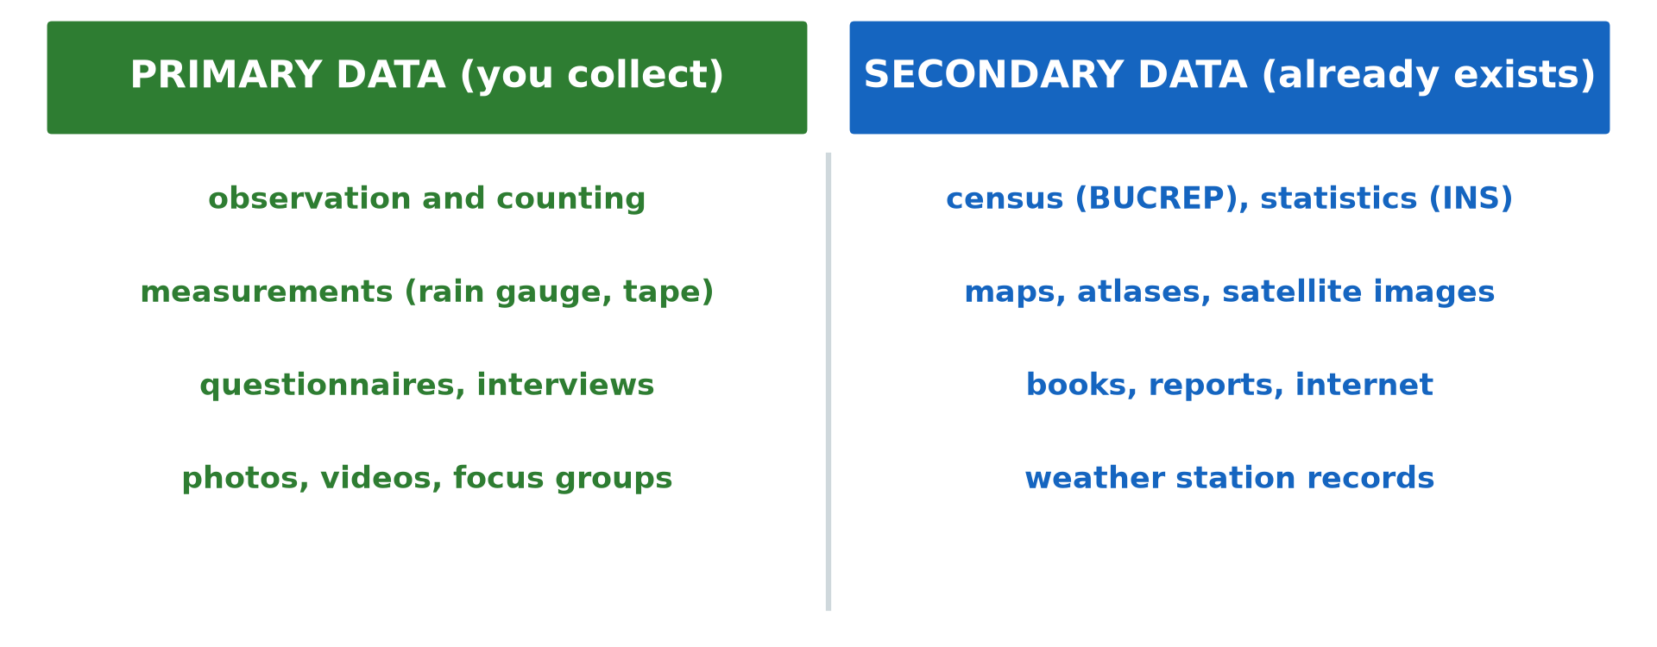
1. SOURCES
Activity 1
Primary and secondary data.
Notes:
Activity 1. Look carefully at this diagram: primary and secondary data. Observe every detail before I ask the question.

Slide 21
1. SOURCES
Activity 1: Question
Is a BUCREP census report primary or secondary data for a student?
Notes:
Here is the question for Activity 1: Is a BUCREP census report primary or secondary data for a student? Take one minute to think and write your answer in your rough notebook.

Slide 22
1. SOURCES
Activity 1: Answer
Secondary data.
Notes:
Let us check the answer together. Secondary data.

Slide 23
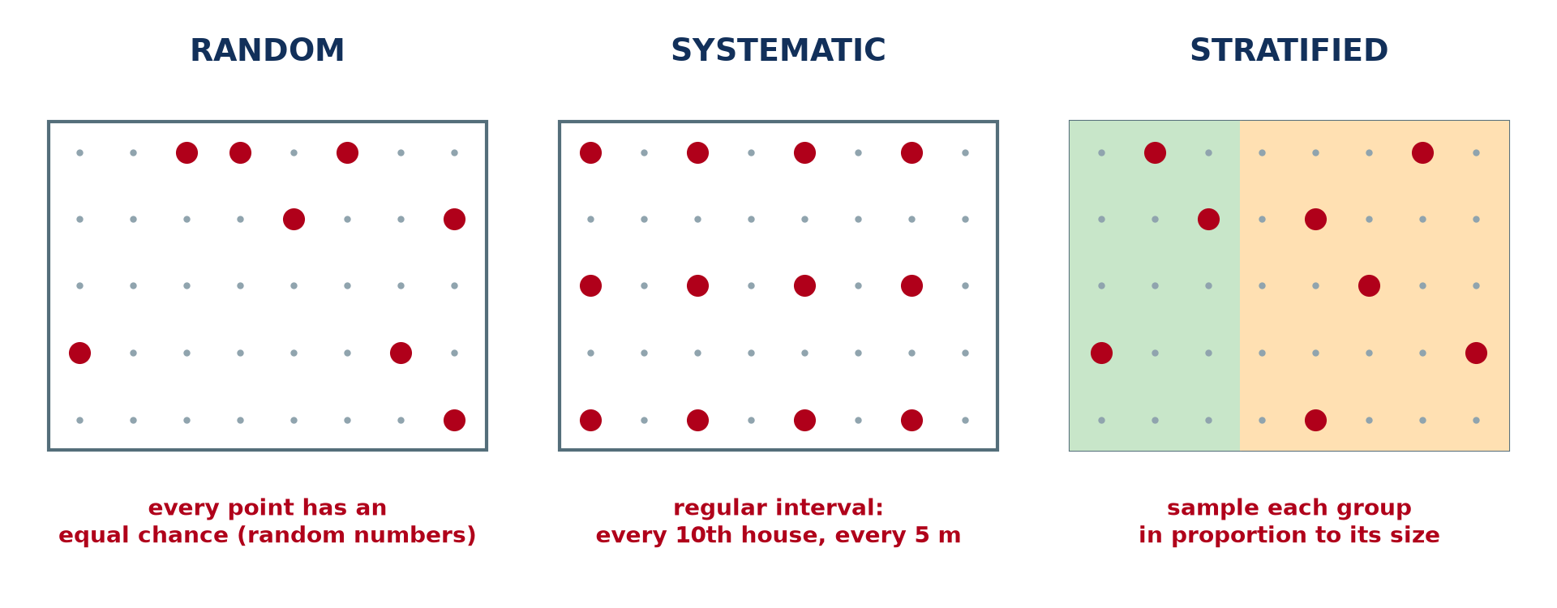
2. SAMPLING
Activity 2
Three sampling methods.
Notes:
Activity 2. Look carefully at this diagram: three sampling methods. Observe every detail before I ask the question.

Slide 24
2. SAMPLING
Activity 2: Question
In which method does every member have an equal chance of being chosen?
Notes:
Here is the question for Activity 2: In which method does every member have an equal chance of being chosen? Take one minute to think and write your answer in your rough notebook.

Slide 25
2. SAMPLING
Activity 2: Answer
Random sampling.
Notes:
Let us check the answer together. Random sampling.

Slide 26
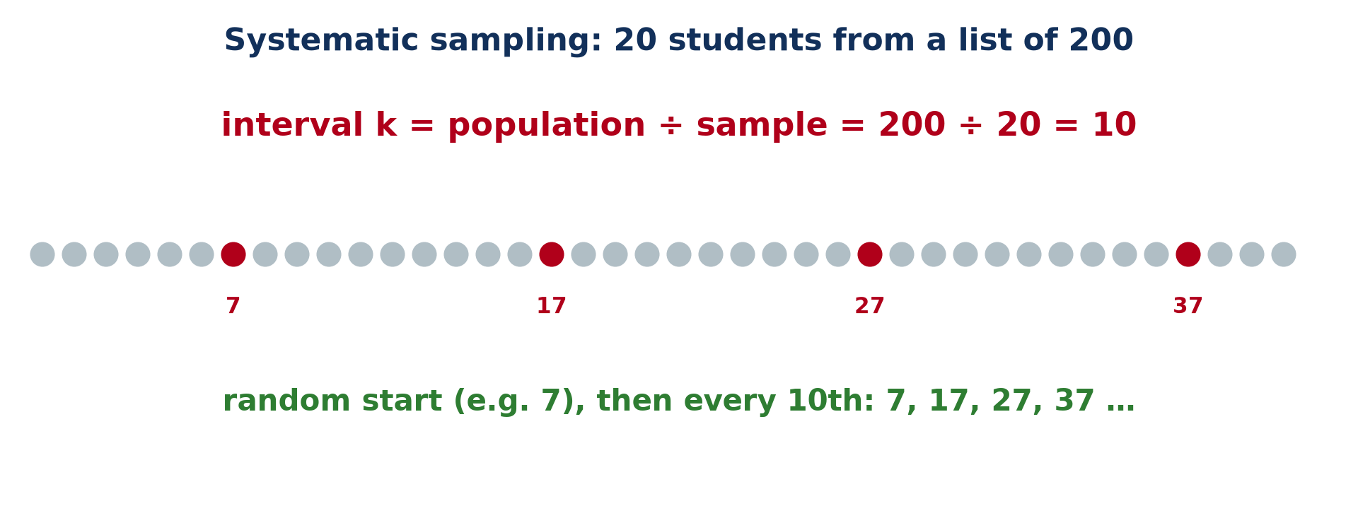
2. SAMPLING
Activity 3
Systematic sampling.
Notes:
Activity 3. Look carefully at this picture: systematic sampling. Observe every detail before I ask the question.

Slide 27
2. SAMPLING
Activity 3: Question
What is the sampling interval for 20 students chosen from 200?
Notes:
Here is the question for Activity 3: What is the sampling interval for 20 students chosen from 200? Take one minute to think and write your answer in your rough notebook.

Slide 28
2. SAMPLING
Activity 3: Answer
k = 200 ÷ 20 = 10.
Notes:
Let us check the answer together. k = 200 ÷ 20 = 10.

Slide 29
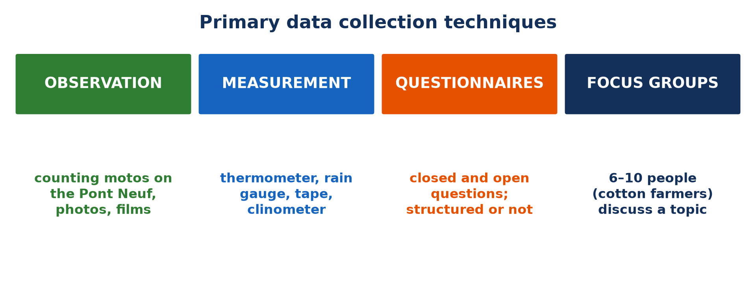
3. TECHNIQUES
Activity 4
Primary data collection techniques.
Notes:
Activity 4. Look carefully at this picture: primary data collection techniques. Observe every detail before I ask the question.

Slide 30
3. TECHNIQUES
Activity 4: Question
How can you study traffic on the Pont Neuf of Garoua?
Notes:
Here is the question for Activity 4: How can you study traffic on the Pont Neuf of Garoua? Take one minute to think and write your answer in your rough notebook.

Slide 31
3. TECHNIQUES
Activity 4: Answer
By counting vehicles for a fixed time (observation and counting).
Notes:
Let us check the answer together. By counting vehicles for a fixed time (observation and counting).

Slide 32
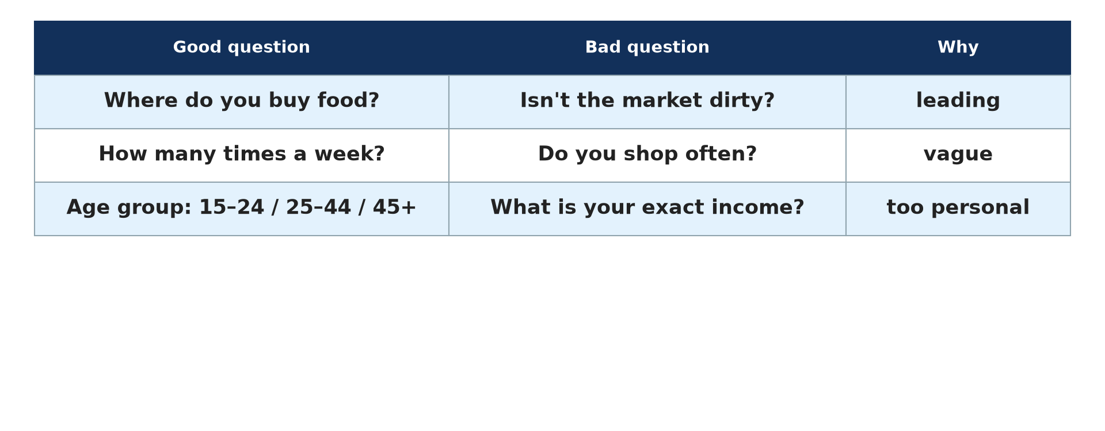
3. TECHNIQUES
Activity 5
Good and bad questions.
Notes:
Activity 5. Look carefully at this diagram: good and bad questions. Observe every detail before I ask the question.

Slide 33
3. TECHNIQUES
Activity 5: Question
Why is "Isn't the market dirty?" a bad question?
Notes:
Here is the question for Activity 5: Why is "Isn't the market dirty?" a bad question? Take one minute to think and write your answer in your rough notebook.

Slide 34
3. TECHNIQUES
Activity 5: Answer
It is a leading question that suggests the answer.
Notes:
Let us check the answer together. It is a leading question that suggests the answer.

Slide 35
BOARD SUMMARY
Board Summary
Topic: Quantitative Techniques in Geography
Sub-topic: Statistical Techniques
Quantitative Techniques 2: Data Collection: Sources and Techniques
Notes:
Now we are going to copy the board summary. Write the title and the headings neatly in your notebooks. I will give you enough time for each slide, so do not rush.

Slide 36
BOARD SUMMARY
DEFINITIONS
The key terms of this lesson are defined as follows:
Geographical data: They are facts and figures collected to study places, people and environments.
Notes:
Let us copy the definitions. The key terms of this lesson are defined as follows. On this slide we have Geographical data. Write each point on a new line, with the key term first, and explain it in your own words when we revise. When you finish, we go to the next slide.

Slide 37
BOARD SUMMARY
DEFINITIONS (continued)
Primary data: They are first-hand data collected by the researcher for a specific purpose.
Secondary data: They are data already collected by someone else for another purpose.
Notes:
We continue with the definitions. On this slide we have Primary data and Secondary data. Write each point on a new line, with the key term first, and explain it in your own words when we revise. When you finish, we go to the next slide.

Slide 38
BOARD SUMMARY
DEFINITIONS (continued)
Population (in statistics): It is the whole group to be studied.
Sample: It is a smaller, representative part of the population.
Notes:
We continue with the definitions. On this slide we have Population (in statistics) and Sample. Write each point on a new line, with the key term first, and explain it in your own words when we revise.

Slide 39
BOARD SUMMARY
1. Sources of Geographical Data
Geographical data come from the following sources:
Primary data: They are original, up to date and specific, collected by fieldwork, observation, measurement, interviews and questionnaires.
Illustration: primary and secondary data
Notes:
Let us copy Sources of Geographical Data. Geographical data come from the following sources. Copy the point on Primary data on the left, then draw the diagram on the right: primary and secondary data. Give it a title and label it clearly.

Slide 40
BOARD SUMMARY
1. Sources of Geographical Data
Example of primary data: Measuring the temperature of the Benue with a thermometer.
Secondary data: They already exist and are cheap and quick to obtain, but may be outdated or not fit the study.
Notes:
We continue with Sources of Geographical Data. On this slide we have Example of primary data and Secondary data. Write each point on a new line, with the key term first, and explain it in your own words when we revise. When you finish, we go to the next slide.

Slide 41
BOARD SUMMARY
1. Sources of Geographical Data (continued)
Sources of secondary data: Books, BUCREP census reports, INS statistics, Cameroon Tribune, maps, websites and reports of the Ministry of Agriculture on cotton production.
Notes:
We continue with Sources of Geographical Data. On this slide we have Sources of secondary data. Write each point on a new line, with the key term first, and explain it in your own words when we revise.

Slide 42
BOARD SUMMARY
2. Basic Sampling Procedures
The basic sampling procedures are the following:
Why sample: It is often impossible, too slow or too costly to study the whole population.
Illustration: three sampling methods
Notes:
Let us copy Basic Sampling Procedures. The basic sampling procedures are the following. Copy the point on Why sample on the left, then draw the diagram on the right: three sampling methods. Give it a title and label it clearly.

Slide 43
BOARD SUMMARY
2. Basic Sampling Procedures
Random sampling: Every member has an equal chance of being chosen, by drawing names from a box or using random numbers; it is unbiased.
Notes:
We continue with Basic Sampling Procedures. On this slide we have Random sampling. Write each point on a new line, with the key term first, and explain it in your own words when we revise.

Slide 44
BOARD SUMMARY
2. Basic Sampling Procedures
Systematic sampling: Members are chosen at a regular interval k = population ÷ sample size, from a random start: for 20 out of 200, k = 10, so the 7th, 17th, 27th and so on.
Illustration: systematic sampling
Notes:
Copy the point on Systematic sampling on the left, then draw the diagram on the right: systematic sampling. Give it a title and label it clearly.

Slide 45
BOARD SUMMARY
2. Basic Sampling Procedures
Stratified sampling: The population is divided into groups (strata), such as forms in a school, and each group is sampled in proportion to its size; it is very representative.
Notes:
We continue with Basic Sampling Procedures. On this slide we have Stratified sampling. Write each point on a new line, with the key term first, and explain it in your own words when we revise.

Slide 46
BOARD SUMMARY
3. Primary Data Collection Techniques
The main techniques of primary data collection are the following:
Observation, counting and recording: Counting cars, motos and lorries on the Pont Neuf in one hour, or photographing house types in Yelwa.
Illustration: collection techniques
Notes:
Let us copy Primary Data Collection Techniques. The main techniques of primary data collection are the following. Copy the point on Observation, counting and recording on the left, then draw the diagram on the right: collection techniques. Give it a title and label it clearly.

Slide 47
BOARD SUMMARY
3. Primary Data Collection Techniques
Measurement: Instruments give precise figures: thermometer, rain gauge, measuring tape (river width), clinometer (slope angle).
Notes:
We continue with Primary Data Collection Techniques. On this slide we have Measurement. Write each point on a new line, with the key term first, and explain it in your own words when we revise.

Slide 48
BOARD SUMMARY
3. Primary Data Collection Techniques
Questionnaires: Written questions answered by respondents, with closed (yes/no, choices) or open questions.
Illustration: good and bad questions
Notes:
Copy the point on Questionnaires on the left, then draw the diagram on the right: good and bad questions. Give it a title and label it clearly.

Slide 49
BOARD SUMMARY
3. Primary Data Collection Techniques
Interviews: Face-to-face or telephone conversations, structured (fixed questions) or unstructured.
Focus group discussions: A guided discussion with 6–10 people sharing a characteristic, such as cotton farmers near Garoua discussing climate change.
Notes:
We continue with Primary Data Collection Techniques. On this slide we have Interviews and Focus group discussions. Write each point on a new line, with the key term first, and explain it in your own words when we revise.

Slide 50
FORMATIVE EVALUATION
Evaluation 1
Distinguish primary data from secondary data, with one example from Garoua for each.
Notes:
Now let us check what you have understood. Question 1: Distinguish primary data from secondary data, with one example from Garoua for each. Answer in your exercise book.

Slide 51
FORMATIVE EVALUATION
Expected Answer
Primary: collected by the researcher (counting motos at a crossroads); secondary: already published (BUCREP census figures).
Notes:
The expected answer is: primary: collected by the researcher (counting motos at a crossroads); secondary: already published (BUCREP census figures). If you got it right, well done.

Slide 52
FORMATIVE EVALUATION
Evaluation 2
Explain how to select 30 people from a list of 600 by systematic sampling.
Notes:
Now let us check what you have understood. Question 2: Explain how to select 30 people from a list of 600 by systematic sampling. Answer in your exercise book.

Slide 53
FORMATIVE EVALUATION
Expected Answer
k = 600 ÷ 30 = 20; choose a random start between 1 and 20, then every 20th person.
Notes:
The expected answer is: k = 600 ÷ 30 = 20; choose a random start between 1 and 20, then every 20th person. If you got it right, well done.

Slide 54
REMEDIATION
Remediation
Fill in the blanks:
Data collected by the researcher are ______ data.
Choosing every 10th house is ______ sampling.
Notes:
Take your time to copy this part; we will continue together.

Slide 55
REMEDIATION
Remediation (continued)
Dividing the population into groups first is ______ sampling.
Notes:
For those who need more practice, fill in the blanks in your exercise book. The answers are: number 1, primary; number 2, systematic; number 3, stratified.

Slide 56
HOMEWORK
Homework
Define the arithmetic mean.
Notes:
For your homework: Define the arithmetic mean. We shall correct it at the beginning of our next lesson.

Slide 57
NEXT LESSON
Next Lesson
Our next lesson will be on:
Quantitative Techniques 3 (Part 1): Measures of Central Tendency, Range and Quartiles
Notes:
Our next lesson will be on Quantitative Techniques 3 (Part 1): Measures of Central Tendency, Range and Quartiles. Thank you for your attention, and see you next time.

Slide 58
BILINGUAL GAME
Bilingual Game (Jeu Bilingue)
English | Français
Data | Les données
Sample | L'échantillon
Observation | L'observation
Questionnaire | Le questionnaire
Interview | L'entretien
Sampling | L'échantillonnage
Notes:
Let us play the bilingual game. I say a word in English, and you give me the French word. Then we do the reverse.

Slide 59
LOGBOOK
Official Logbook (1/2)
Module / Topic | Quantitative Techniques in Geography
Lesson Title | Quantitative Techniques 2: Data Collection: Sources and Techniques
Expected Learning Outcomes | Distinguish primary and secondary data with examples. Explain why sampling is used. Describe random, systematic and stratified sampling. Describe the main primary data collection techniques.
Competence | Learners are able to choose sources, sampling methods and techniques to collect data for a geographical investigation in Garoua.
Notes:
I record this information in the official logbook of the class after the lesson.

Slide 60
LOGBOOK
Official Logbook (2/2)
Matter Taught | DEFINITIONS; Sources of Geographical Data; Basic Sampling Procedures; Primary Data Collection Techniques.
Evaluation | Formative evaluation and remediation exercise.
Homework | Define the arithmetic mean.
Enrolment / Present / Absent | ____ / ____ / ____
Achievement | To be completed after the lesson.
Notes:
I complete the second page of the logbook: the matter taught, the evaluation, the homework and the attendance.

Slide 61
TEACHER'S NOTE
Teacher's Note
Timing: Homework correction, plan, objectives 8 min | Recall, situation, action 10 min | 5 activities 30 min | Board summary (copying) 30 min | Evaluation, remediation 10 min | Homework, next lesson 5 min | Logbook 7 min
Without the projector (Activity 1): list sources in two columns.
Without the projector (Activity 2): pick names from a box.
Without the projector (Activity 3): select every 10th name on the class list.
Without the projector (Activity 4): prepare a tally sheet.
Without the projector (Activity 5): write two closed questions.
Notes:
This slide is for me, the teacher: it gives the timing of the lesson and what to do if the projector is not available.

Slide 62
REFERENCES
References
Geography Syllabus for Sixth Forms (Lower and Upper Sixth), MINESEC, 2019 — Module 8 (Practical Geography).
Teacher's course notes: Mr KAMDEM E., Statistical Techniques in Geographical Analysis (USA), GBHS Garoua, 2026.
Diagrams and animations: drawn for this lesson (Geography Department).
Notes:
These are the references and picture credits used to prepare this lesson.

